Slide 1
Energy Efficient Multipath Routing Protocol for Mobile ad-hoc Network Using the Fitness Function

Slide 2
ABSTRACT:
We propose a system which highlights very specific problem of energy consumption in MANET by applying the Fitness Function technique to optimize the energy consumption in Ad Hoc On Demand Multipath Distance Vector (AOMDV) routing protocol. The proposed protocol is called Ad Hoc On Demand Multipath Distance Vector with the Fitness Function (FF-AOMDV). The fitness function is used to find the optimal path from the source to the destination to reduce the energy consumption in multipath routing.

Slide 3
EXISTING SYSTEM:
The Existing System approaches an Energy-entropy Multipath Routing optimization algorithm in MANET based on GA (EMRGA). The key idea of the protocol was to find the minimal node residual energy of each route in the process of selecting a path by descending node residual energy. It can balance individual nodes battery power utilization and hence prolong the entire networks lifetime and energy variance.

Slide 4
DISADVANTAGES OF EXISTING SYSTEM:
Less Packet delivery ratio
Low Throughput
High End-to-end-delay
More Energy consumption and Less Network lifetime.

Slide 5
PROPOSED SYSTEM:
We proposed a new multipath routing protocol called the FF-AOMDV routing protocol, which is a combination of Fitness Function and the AOMDV’s protocol. In a normal scenario, when a RREQ is broadcasted by a source node, more than one route to the destination will be found and the data packets will be forwarded through these routes without knowing the routes’ quality. By implementing the proposed algorithm on the same scenario, the route selection will be totally different. When a RREQ is broadcast and received, the source node will have three (3) types of information in order to find the shortest and optimized route path with minimized energy consumption.

Slide 6
ADVANTAGES OF PROPOSED SYSTEM:
High Packet delivery ratio.
Increase Throughput.
Low End-to-end-delay
Less Energy consumption and More Network lifetime.

Slide 7
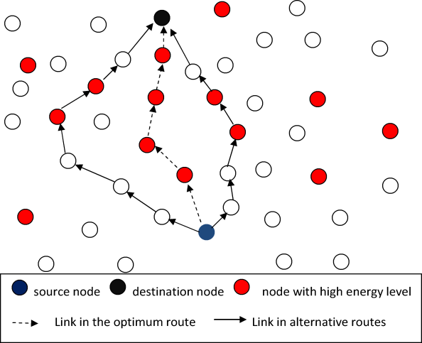
SYSTEM ARCHITECTURE:

Slide 8
HARDWARE REQUIREMENTS:
System : Pentium IV 2.4 GHz.
Hard Disk : 40 GB.
Floppy Drive : 1.44 Mb.
Monitor : 15 VGA Colour.
Mouse : Logitech.
Ram : 512 Mb.

Slide 9
SOFTWARE REQUIREMENTS:
Operating system : Windows XP/UBUNTU.
Implementation : NS2
NS2 Version : NS2.2.28
Front End : OTCL (Object Oriented Tool Command Language)
Tool : Cygwin (To simulate in Windows OS)

Slide 10
REFERENCE
Mueen Uddin, Aqeel Taha, Raed Alsaqour, Tanzila Saba, “Energy Efficient Multipath Routing Protocol for Mobile ad-hoc Network Using the Fitness Function”, IEEE Access, 2017.

